Slide 1


Human - Computer
Interaction
Present by Chi Nguyen

Slide 2
CONTENTS OF THIS CHAPTER
Interaction design basics
Persona
Central message
The process of design

Slide 3
INTERACTION DESIGN BASICS
Design
  What it is, interventions, goals, constraints…
The design process
  What happens when
Users
  Why they are, what they are like...
Scenarios
  Rich stories of design
Navigation
  Finding your way around a system
Iteration and prototypes
  Never get it right first time!

Slide 4
INTERACTIONS
&
INTERVENTIONS
INTERACTIONS
INTERVENTIONS
DESIGN INTERACTIONS
NOT JUST INTERFACE
DESIGN INTERVENTIONS
NOT JUST ARTEFACTS
Not just the immediate interaction
Not just the system, but also…
- Documentation, manuals, tutorials
- What we say and do as well as
what we make

Slide 5
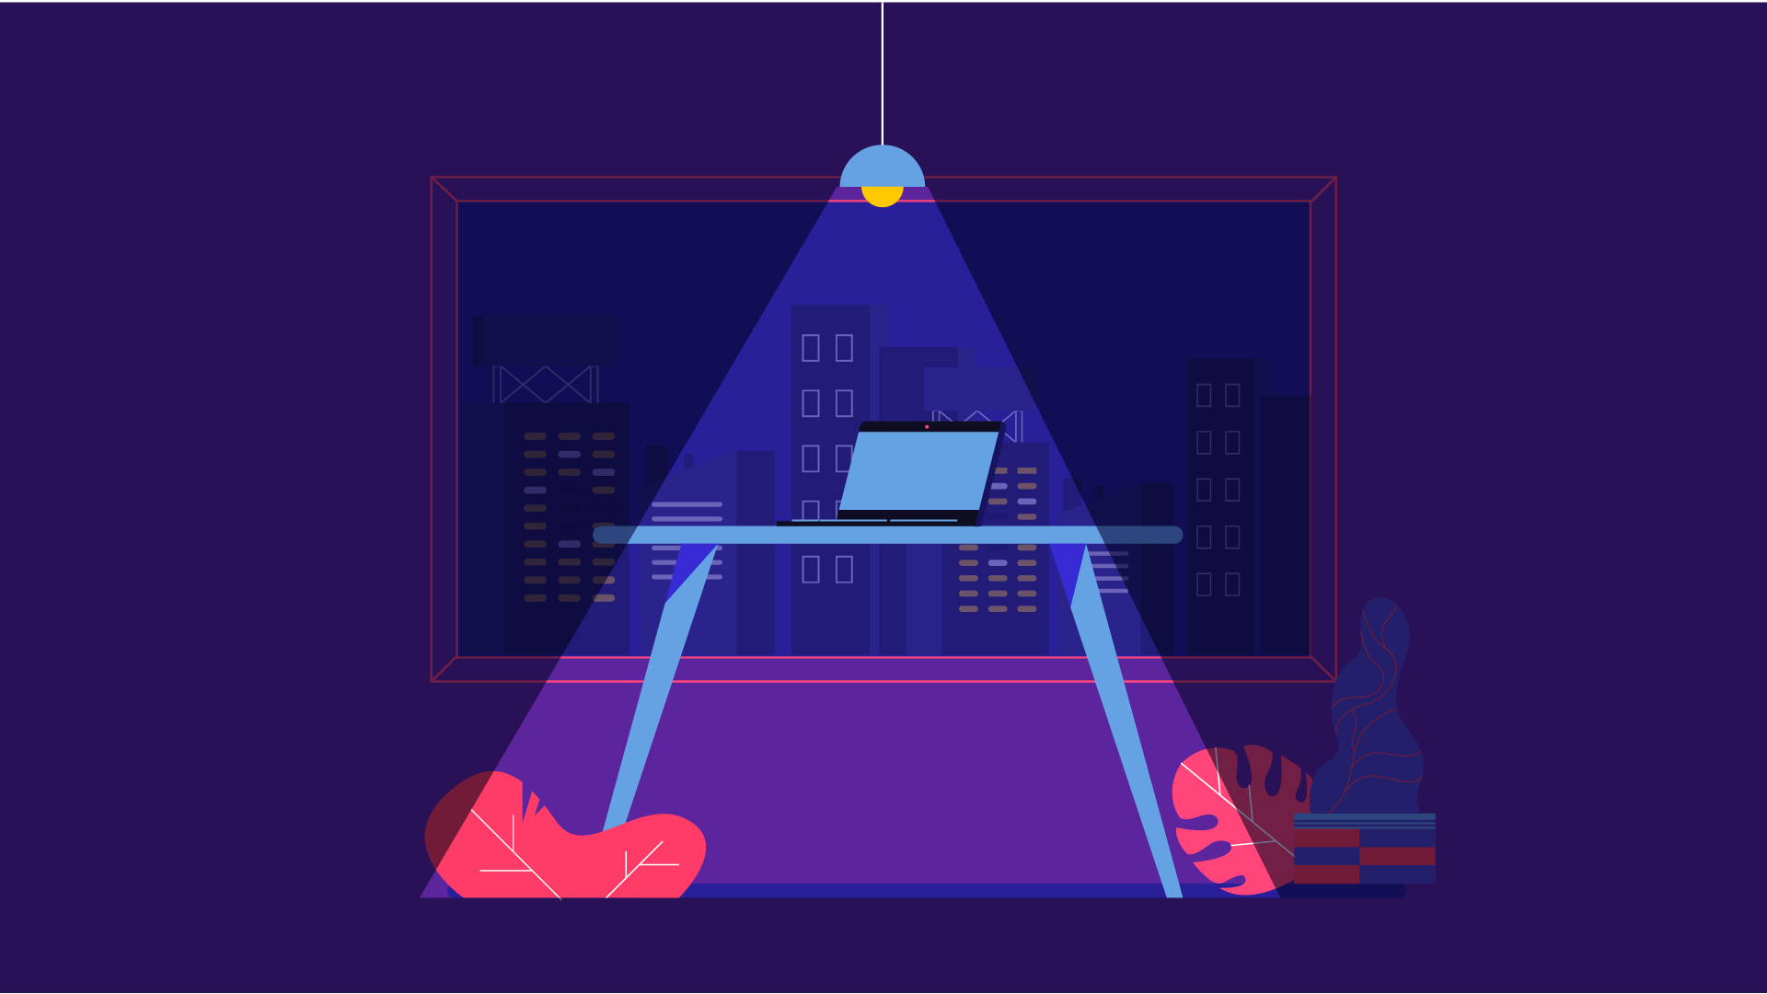
WHAT IS DESIGN?

Slide 6
WHAT
IS
DESIGN?
GOALS
CONTRAINTS
TRADE-OFFS
Who is it for
Why do they want it
…
Materials
Platforms
…
Choosing solution
between goals or constraints

Slide 7
GOLDEN RULES
OF DESIGN
“Understand your materials”
for Human-Computer Interaction
“Understand your materials”...

Slide 8
THE PROCESS OF DESIGN
Often HCI professionals complain that they are called in too late.
  A system has been designed and built, and only when it proves unusable do they think to ask how to do it right!
  In other companies usability is seen as equivalent to testing called checking.
Notes:
-Ngành học nghiên cứu lý thuyết
+ Nghiên cứu mọi người tương tác với công nghệ (máy tính)
- Ngành học thiết kế
+ Thiết kế các biện pháp can thiệp cho các hệ thống liên quan đến con người và công nghệ

Slide 9
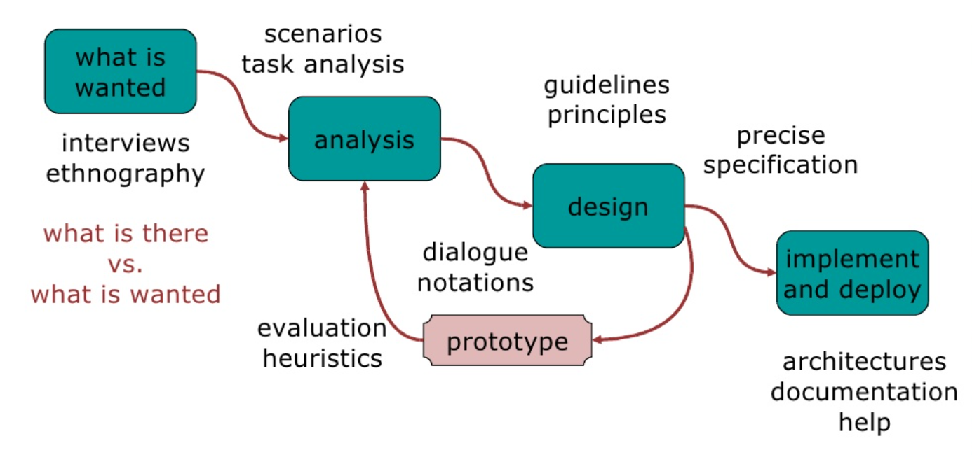
THE PROCESS OF DESIGN
Notes:
-Ngành học nghiên cứu lý thuyết
+ Nghiên cứu mọi người tương tác với công nghệ (máy tính)
- Ngành học thiết kế
+ Thiết kế các biện pháp can thiệp cho các hệ thống liên quan đến con người và công nghệ

Slide 10
STEPS
01
03
02
04
REQUIREMENTS
DESIGN
Here you could describe the topic of the section
Here you could describe the topic of the section
ANALYSIS
OUR TEAM
Here you could describe the topic of the section
Here you could describe the topic of the section

Slide 11
STEPS
REQUIREMENT
ANALYSIS
DESIGN
ITERATION & PROTOTYPING
IMPLEMENT & DEPLOYENT
What is there and what is wanted
Ordering and understanding
What to do and how to decide
Getting it right … and finding what is really needed!
Making it and getting it out there
1
2
3
4
5

Slide 12


HOW CAN I DO IT ALL?
Limited time ⇒ design trade-off
Usability?
– finding problems and fixing them?
– deciding what to fix?
A perfect system is badly designed
– too good Þ too much effort in design

Slide 13
USER FOCUS
Know your user
Persona
Cultural probes

Slide 14
USER
FOCUS
KNOW YOUR USER
PERSONA
CULTURAL PROBES
Who are they?
Probably not like you!
Talk to them
Watch them
Use your imagination
Description of an ‘example’ user
– not necessarily a real person
Use as surrogate user
– what would Betty think
details matter
– makes her ‘real’
Direct observation
- Sometimes hard
  In the home
  Psychiatric patients..
Probes packs
- Items to prompt responses
- Given to people to open in their own environment they record what is meaningful to them
Used to...
- inform interviews, prompt ideas, enculture designers.
Notes:
KNOW YOUR USER:
Who are they?
Probably not like you!
Talk to them
Watch them
Use your imagination
PERSONA:
Description of an ‘example’ user
– not necessarily a real person
Use as surrogate user
– what would Betty think
details matter
– makes her ‘real’
CULTURAL PROBES
Direct observation
- Sometimes hard
In the home
Psychiatric patients..
Probes packs
- Items to prompt responses
Ex: glass to listen at wall, camera, postcard
- Given to people to open in their own environment they record what is meaningful to them
Used to...
- inform interviews, prompt ideas, enculture designers.

Slide 15
USER
FOCUS
PERSONA
KNOW YOUR USER
CULTURAL PROBES
Who are they?
Probably not like you!
Talk to them
Watch them
Use your imagination
Description of an ‘example’ user
– not necessarily a real person
Use as surrogate user
– what would Betty think
details matter
– makes her ‘real’
Direct observation
- Sometimes hard
  In the home
  Psychiatric patients..
Probes packs
- Items to prompt responses
- Given to people to open in their own environment they record what is meaningful to them
Used to...
- inform interviews, prompt ideas, enculture designers.
Notes:
KNOW YOUR USER:
Who are they?
Probably not like you!
Talk to them
Watch them
Use your imagination
PERSONA:
Description of an ‘example’ user
– not necessarily a real person
Use as surrogate user
– what would Betty think
details matter
– makes her ‘real’
CULTURAL PROBES
Direct observation
- Sometimes hard
In the home
Psychiatric patients..
Probes packs
- Items to prompt responses
Ex: glass to listen at wall, camera, postcard
- Given to people to open in their own environment they record what is meaningful to them
Used to...
- inform interviews, prompt ideas, enculture designers.

Slide 16
SCENARIOS
WHAT WILL USERS WANT TO DO?
STEP-BY-STEP WALKTHROUGH
What can they see (sketches, screen shots)
What do they do (keyboard, mouse …)
What are they thinking?
USE AND REUSE THROUGHOUT DESIGN

Slide 17
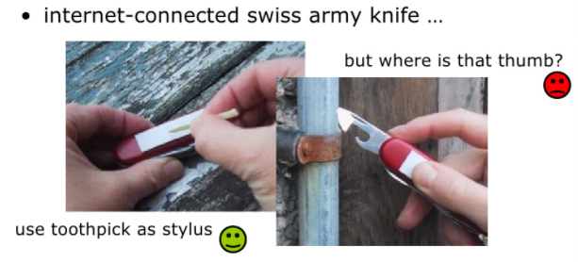
PLAY ACT
Mock up device
Pretend you are doing it

Slide 18
EXPLORE THE DEPTHS
EXPLORE INTERACTION
- What happens when
EXPLORE COGNITION
- What are the users thinking
EXPLORE ARCHITECTURE
- What is happening inside

Slide 19

SCENARIOS
STORY FOR DESIGN
LINEARITY
Communicate with others
Validate other models
Understand dynamics
Time is linear
Our lives are linear
But don’t show alternatives
Log in ...

Slide 20
use SCENARIOS
to...
COMMUNICATE WITH OTHERS
- designers, clients, users
VALIDATE OTHER MODELS
- “play” it against other models
EXPRESS DYNAMICS
- Screenshots - appearance
- Scenario - behavior

Slide 21
SCENARIOS
-
LINEARITY
One line path through system
Pros:
- Life and time are linear
- Easy to understand (stories and narrative are natural)
- Concrete (errors less likely)
Cons:
- No choice, no branches, no special conditions
- Miss the unintended
So:
- Use several scenarios
- Use several methods

Slide 22
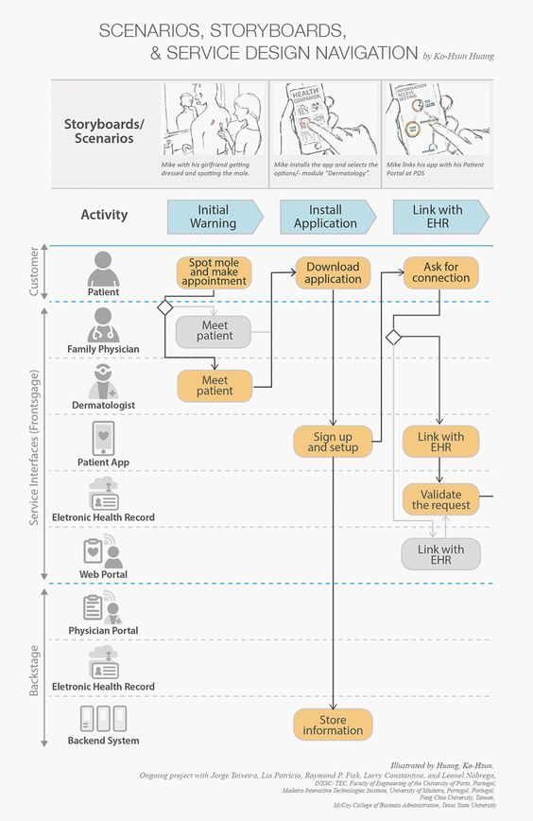
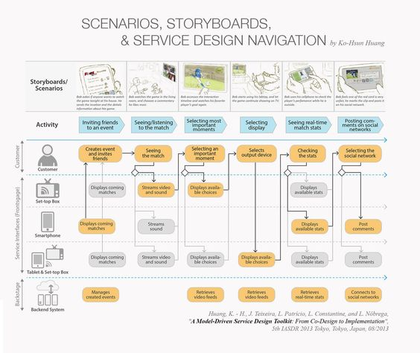
Example

Slide 23
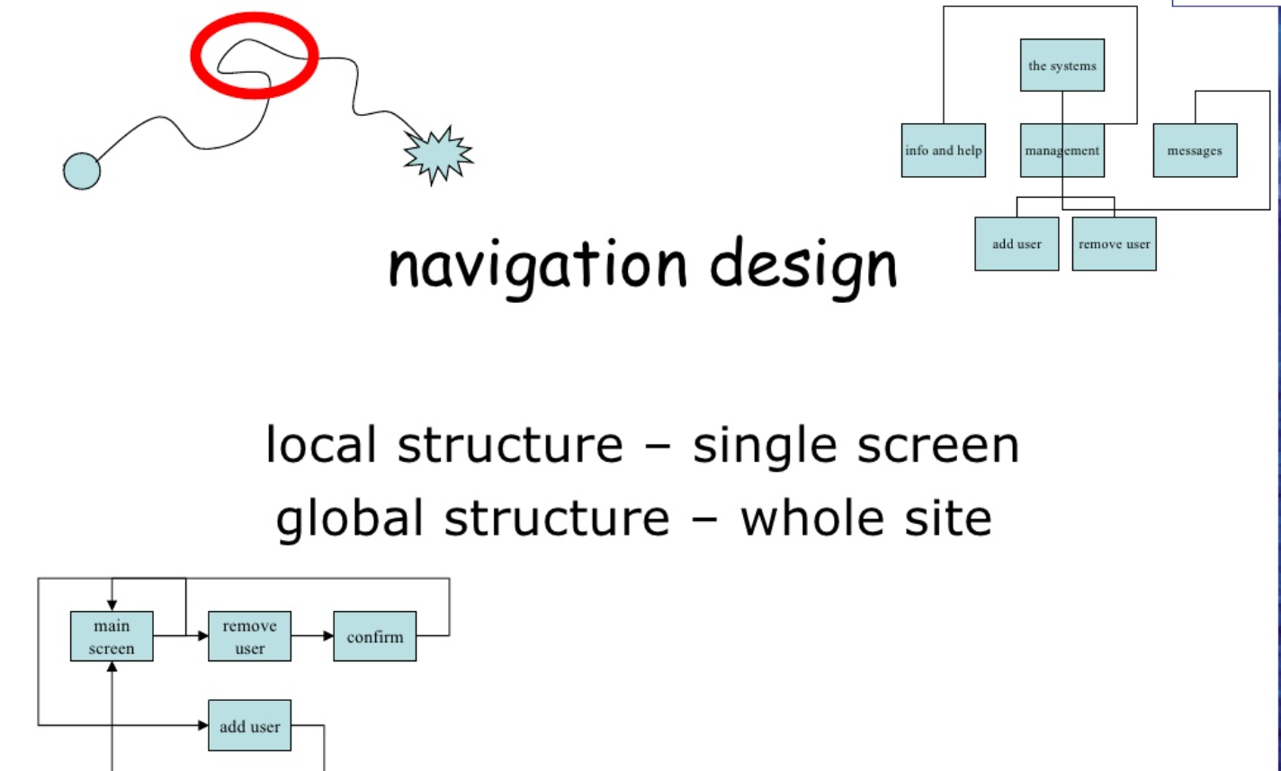
SCENARIOS
-
LINEARITY
One line path through system
Pros:
- Life and time are linear
- Easy to understand (stories and narrative are natural)
- Concrete (errors less likely)
Cons:
- No choice, no branches, no special conditions
- Miss the unintended
So:
- Use several scenarios
- Use several methods

Slide 24
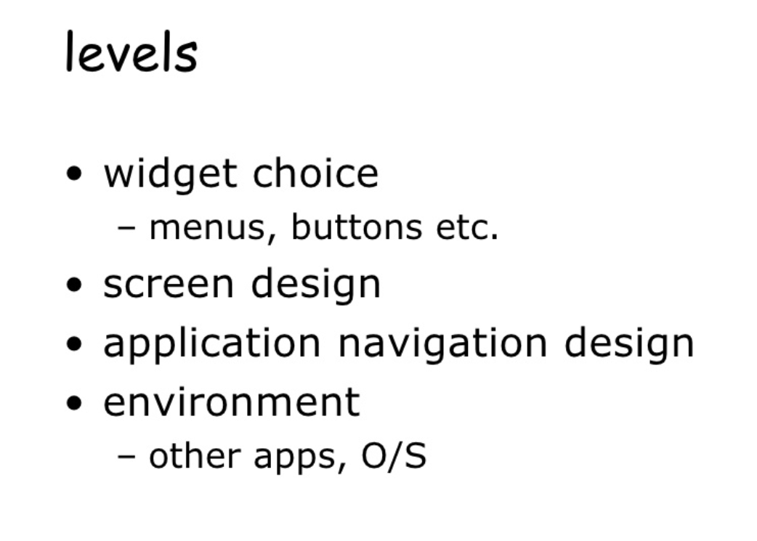

Slide 25
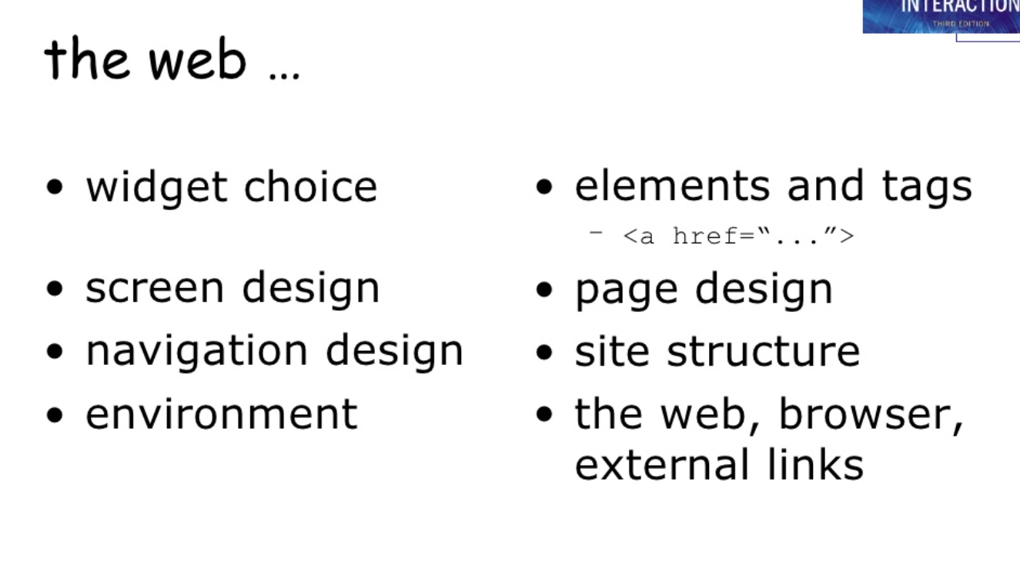

Slide 26
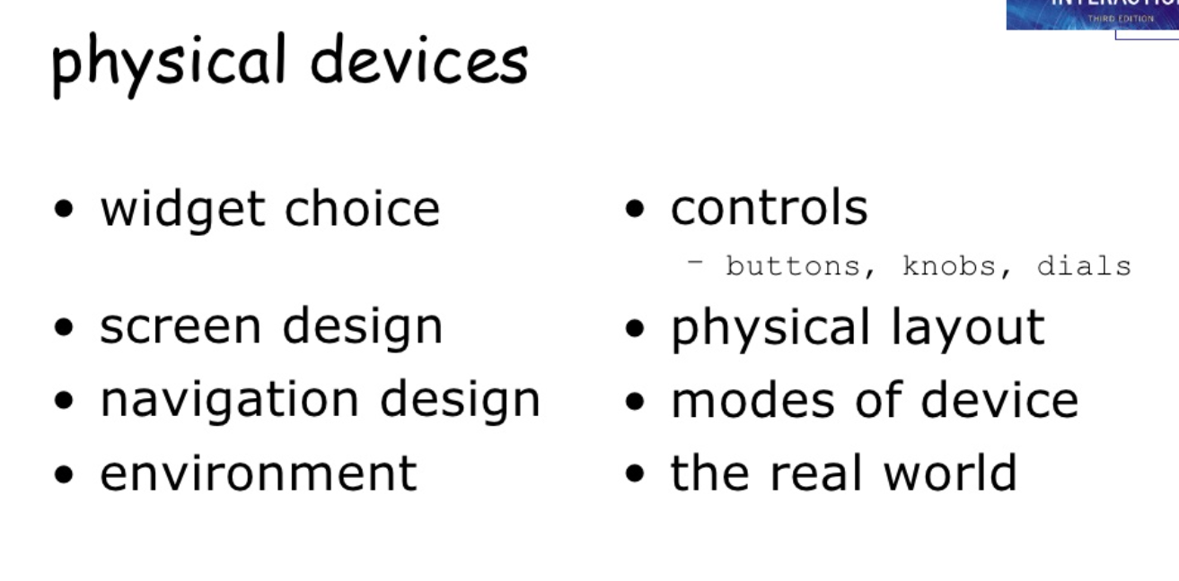

Slide 27
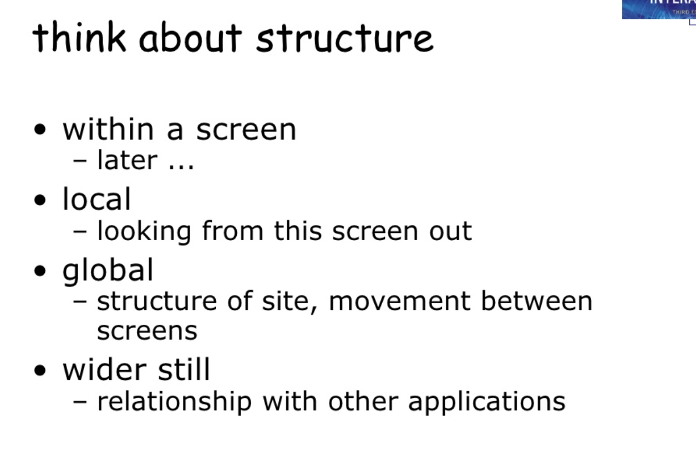

Slide 28
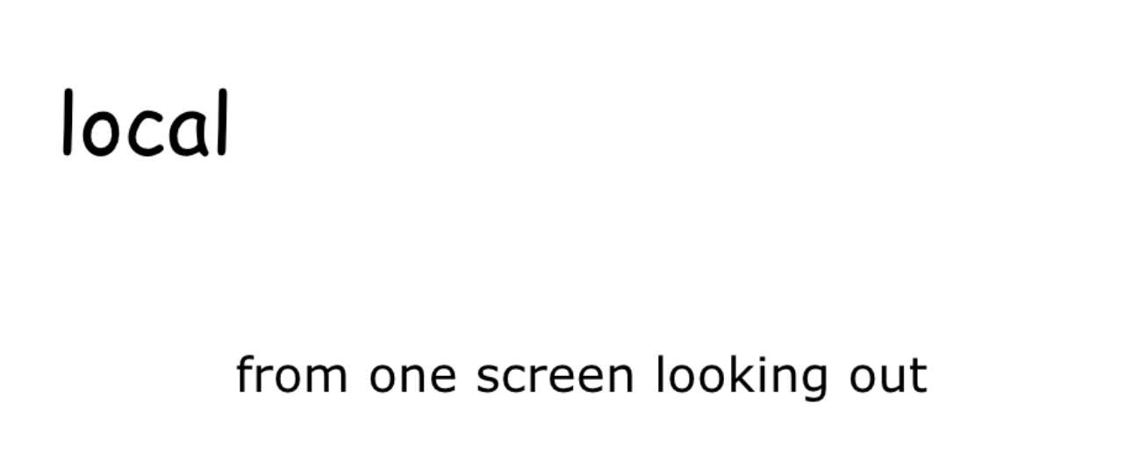

Slide 29
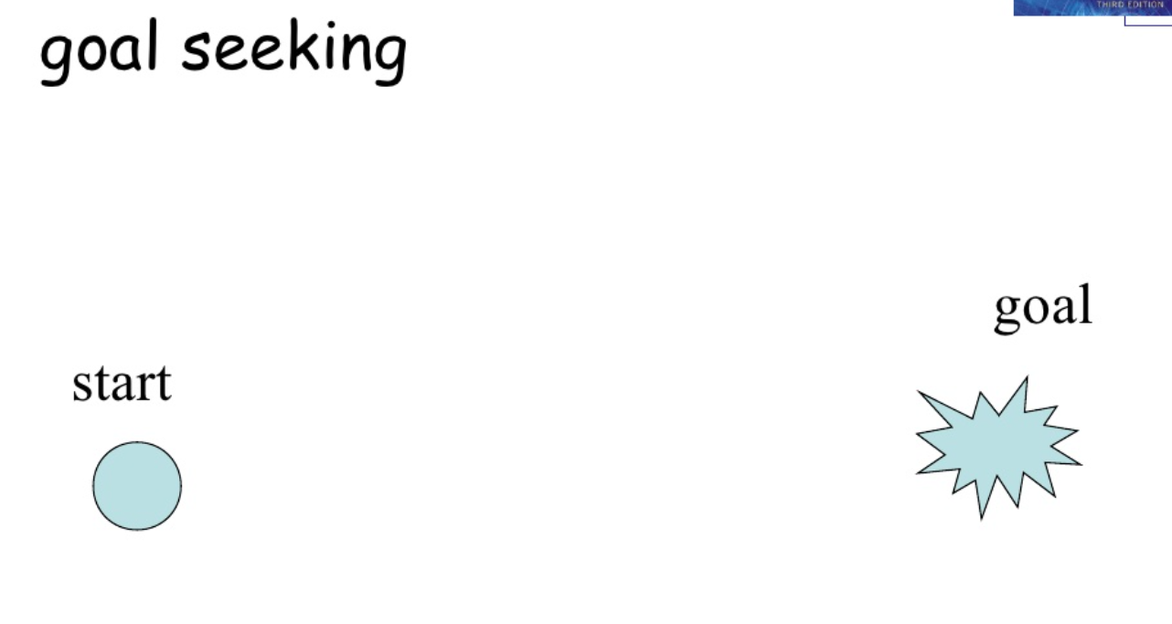

Slide 30
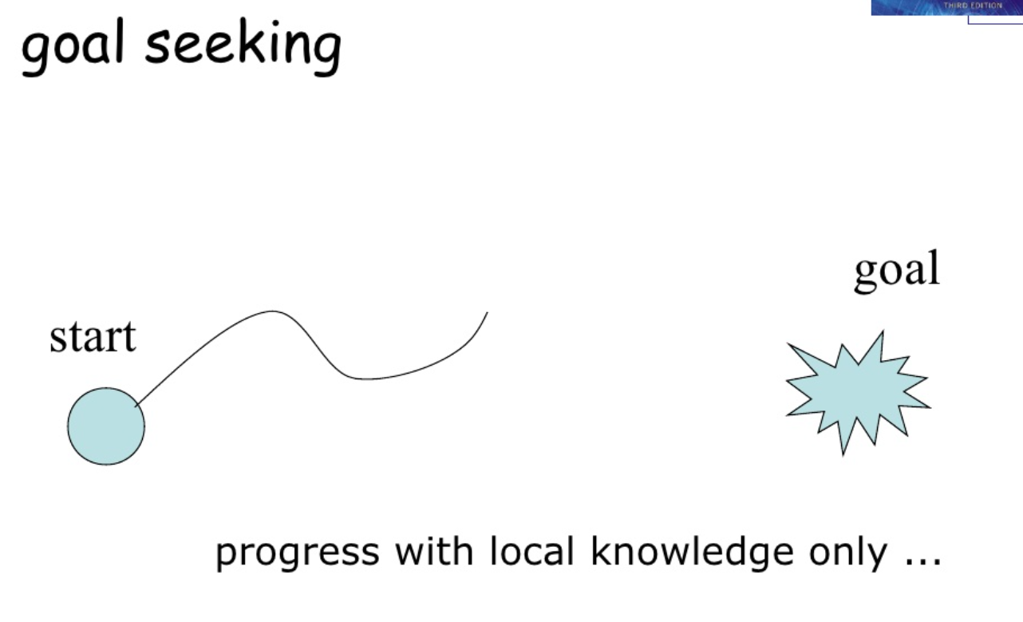

Slide 31
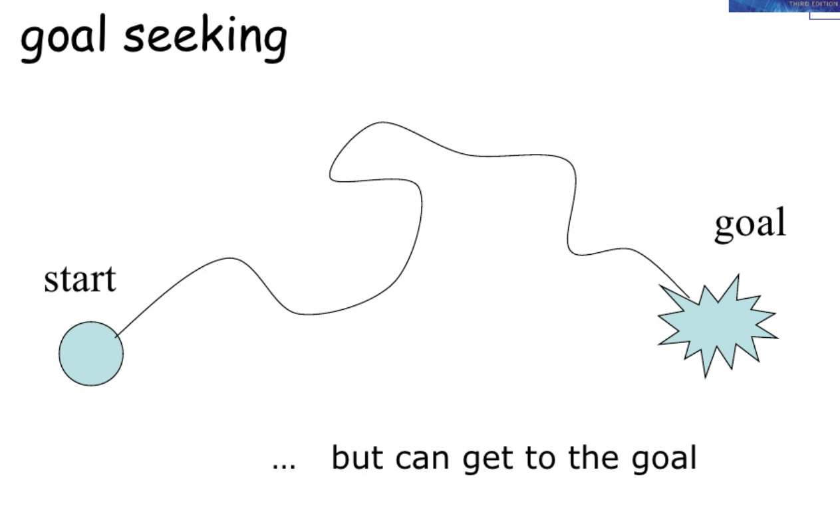

Slide 32
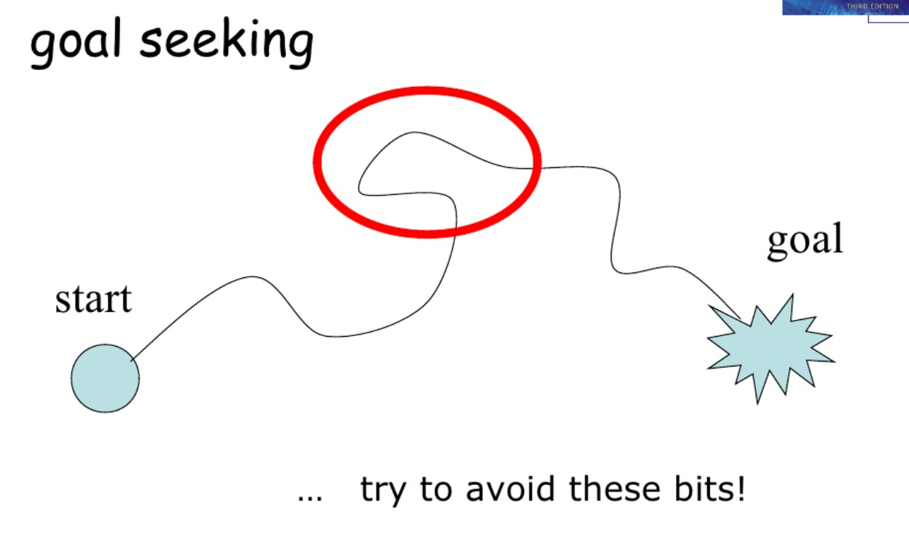

Slide 33
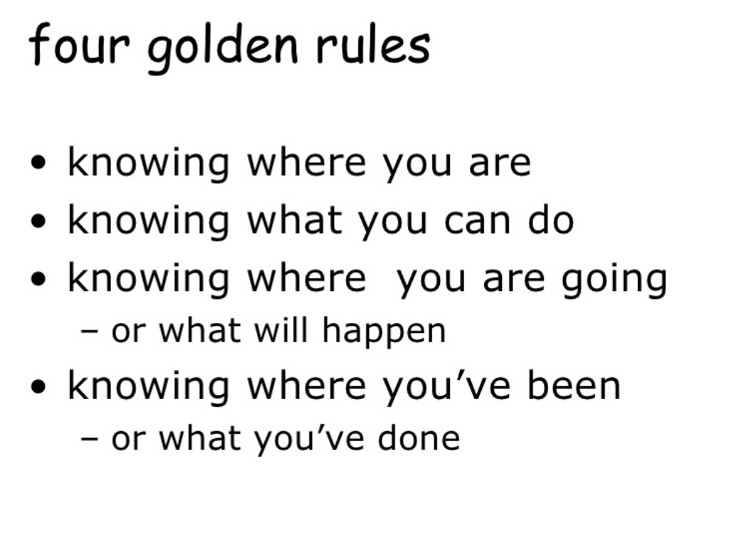

Slide 34
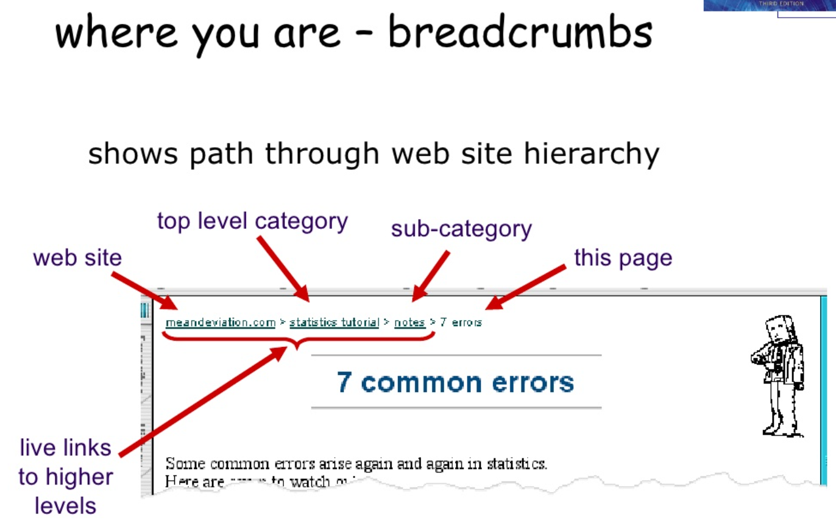

Slide 35
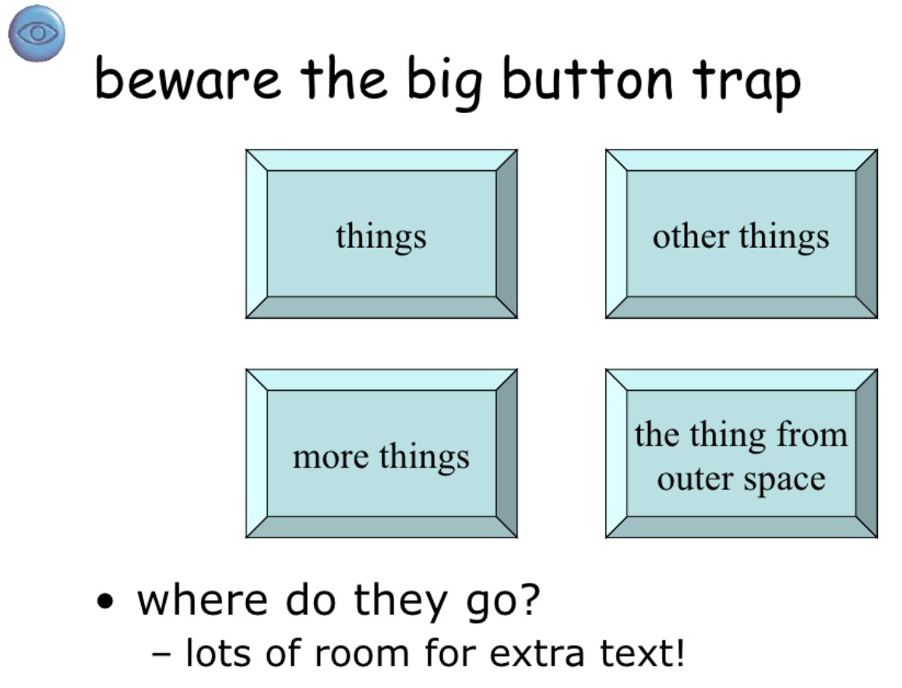

Slide 36
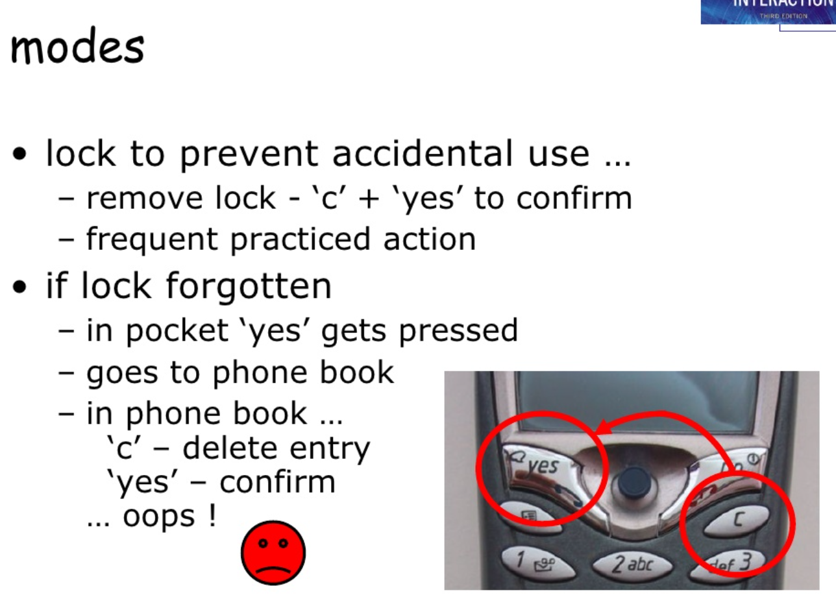

Slide 37
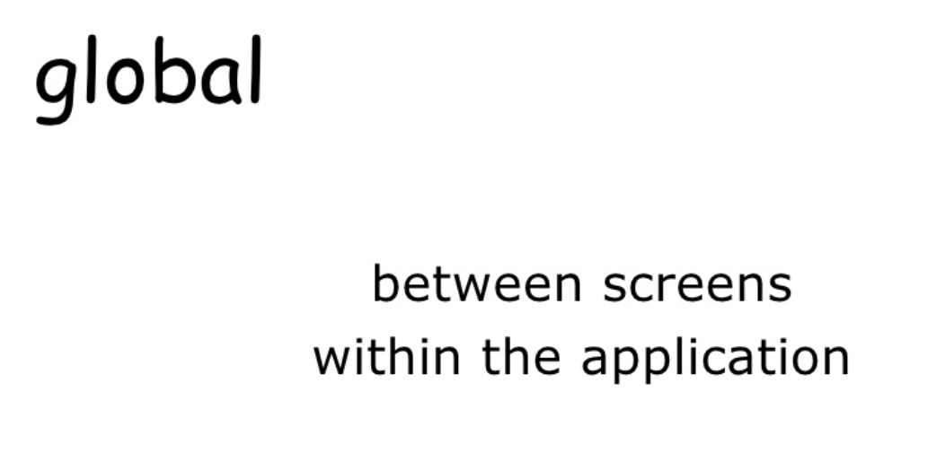

Slide 38
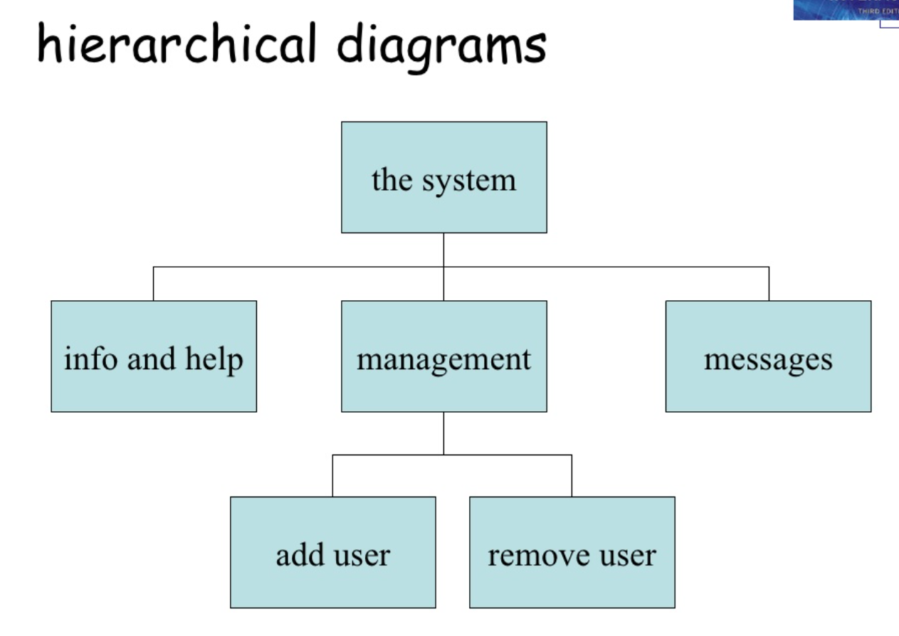

Slide 39
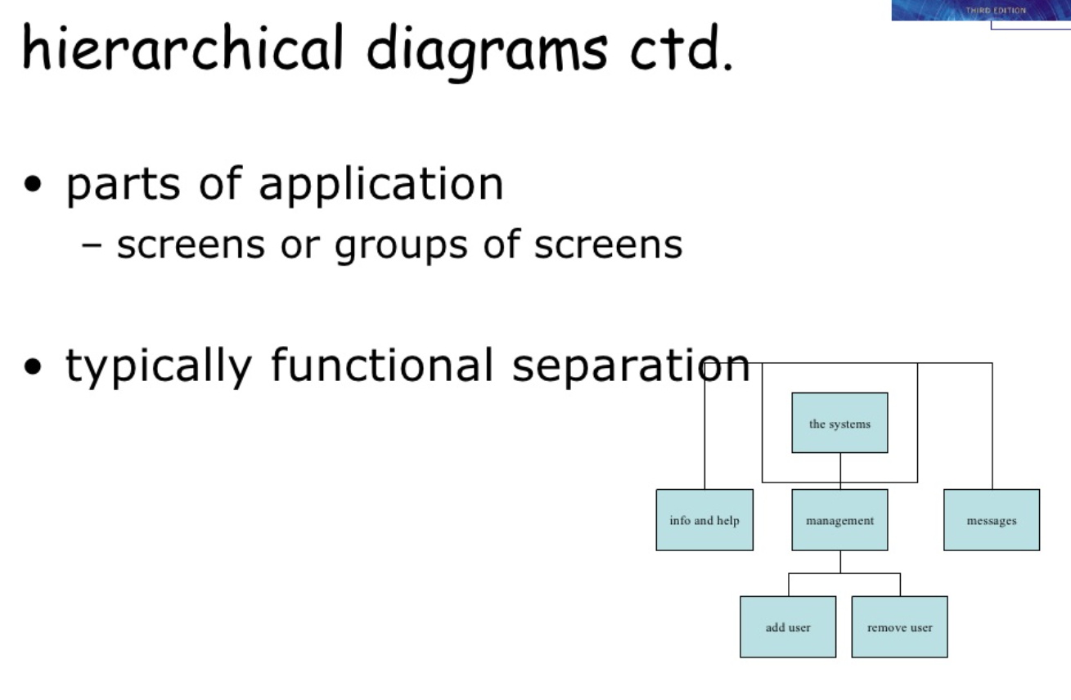

Slide 40
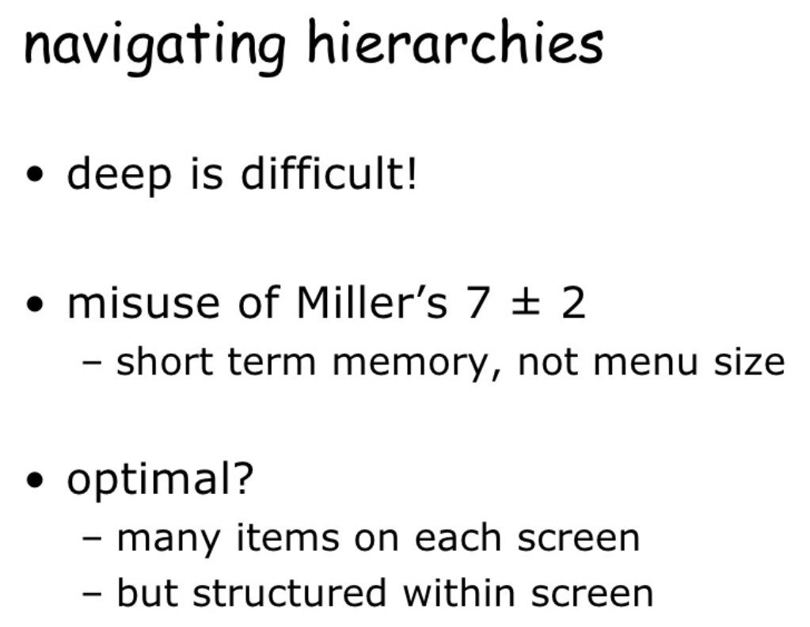

Slide 41
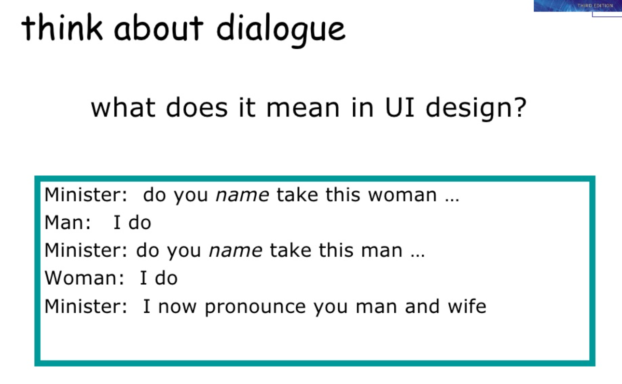

Slide 42
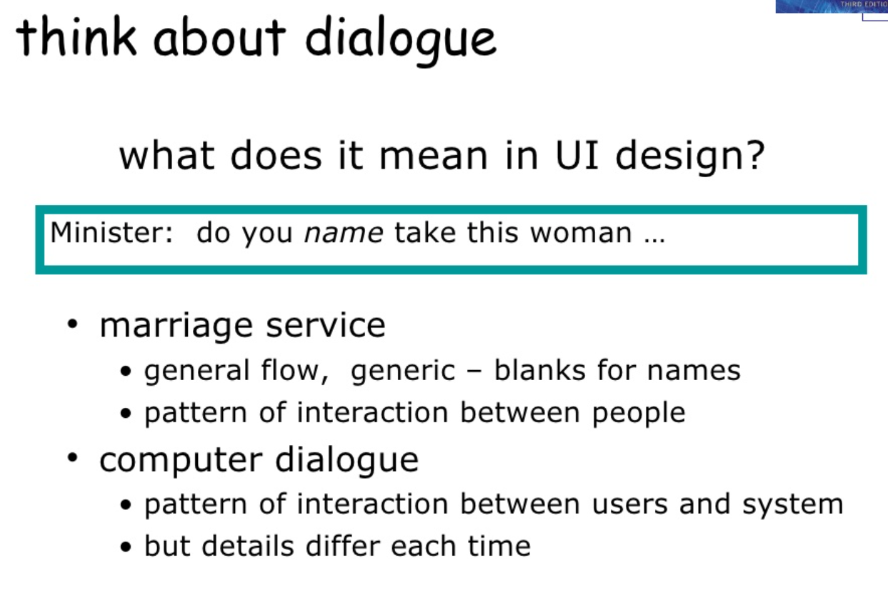

Slide 43
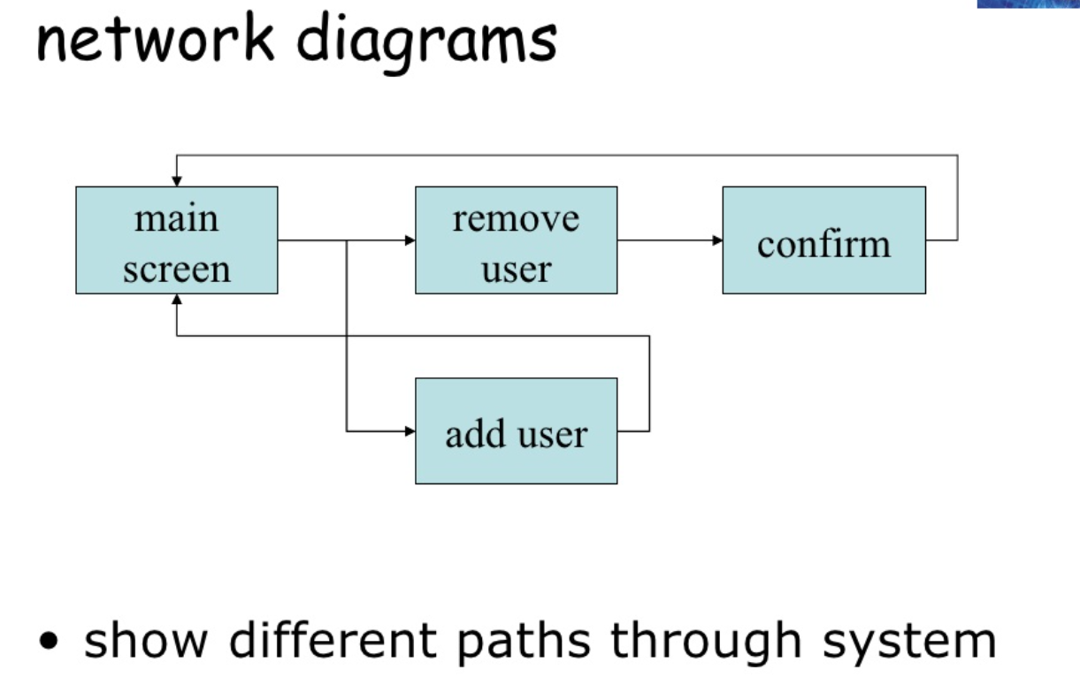

Slide 44
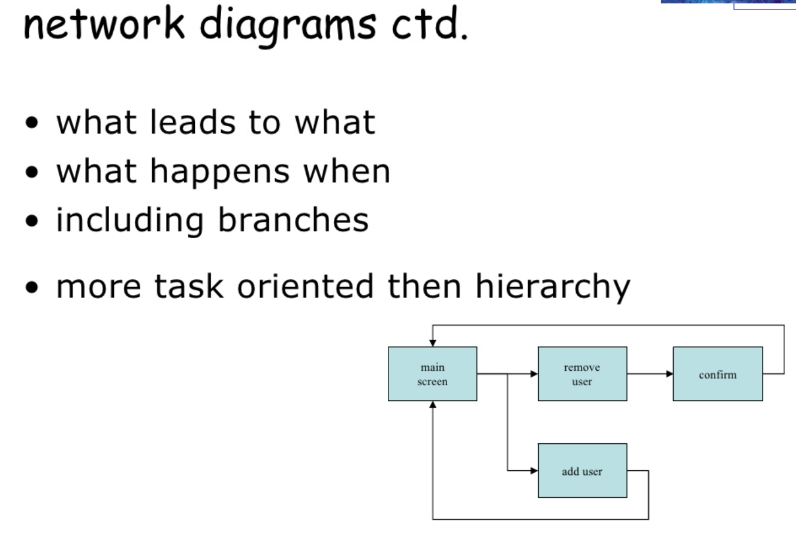

Slide 45
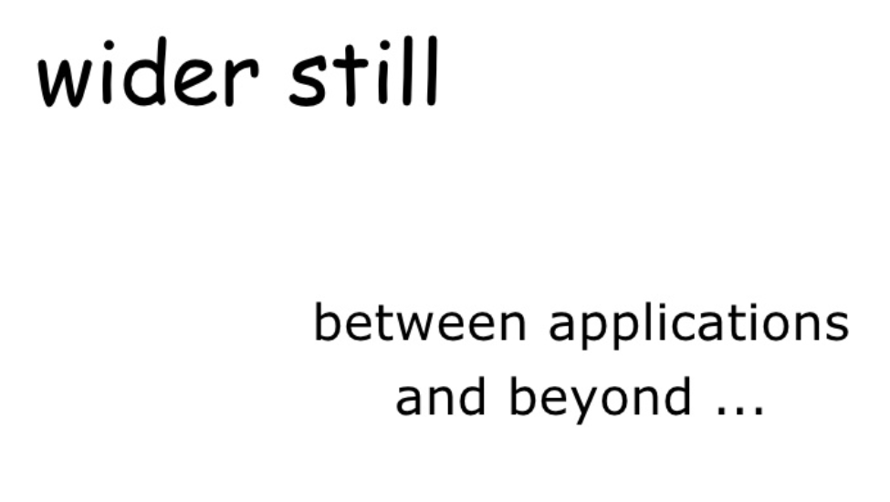

Slide 46
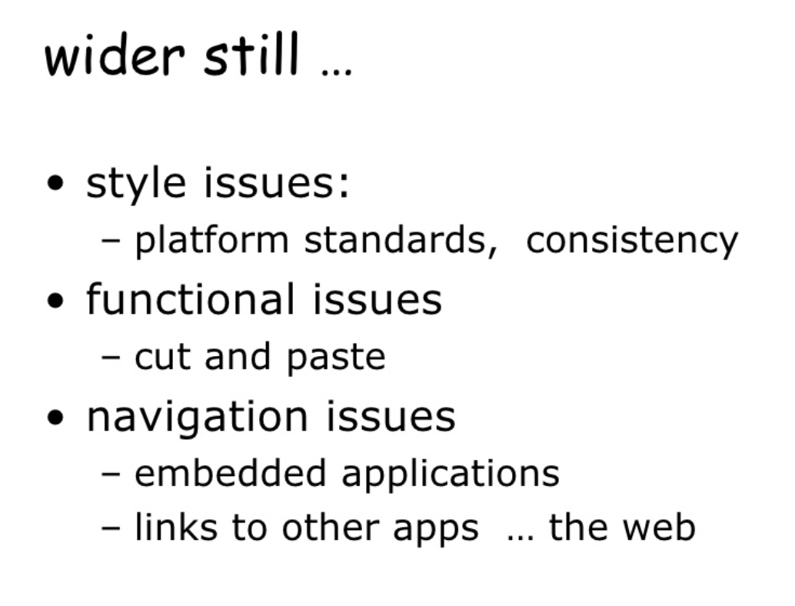

Slide 47
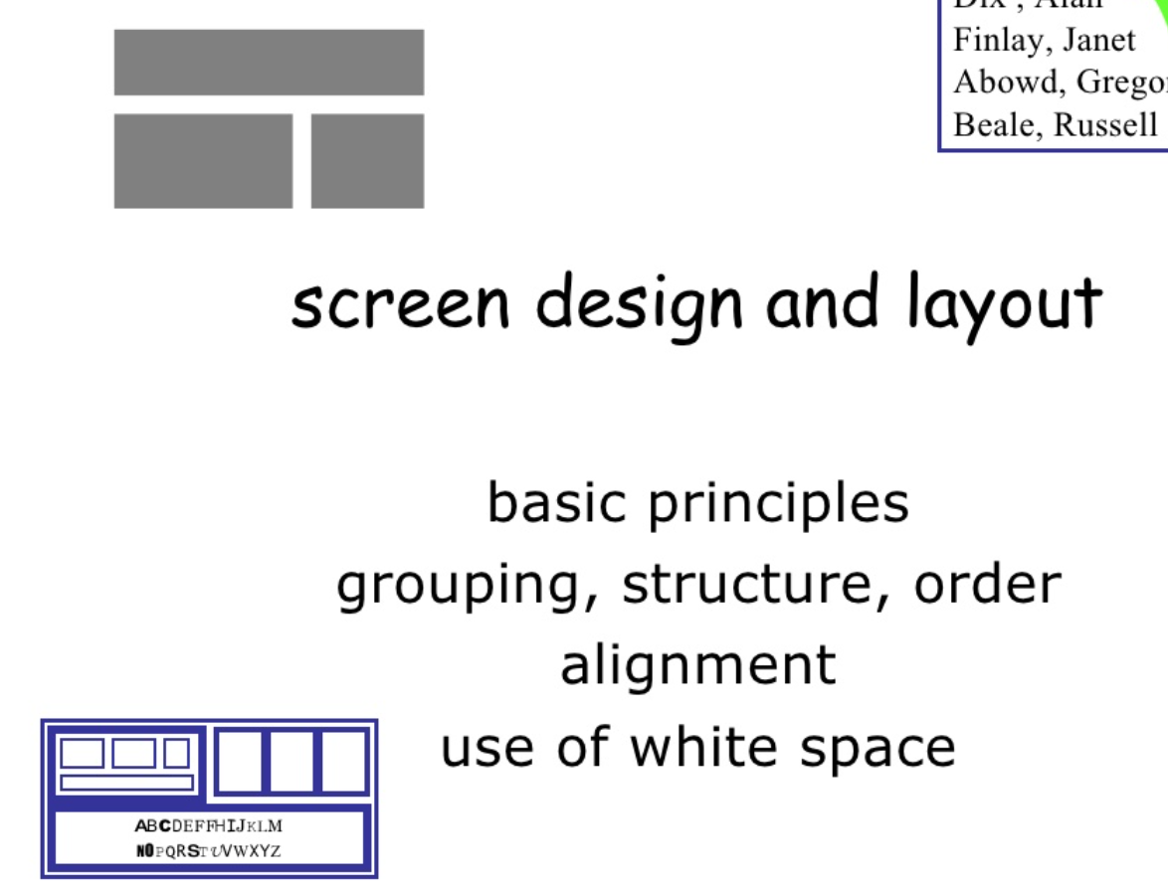

Slide 48
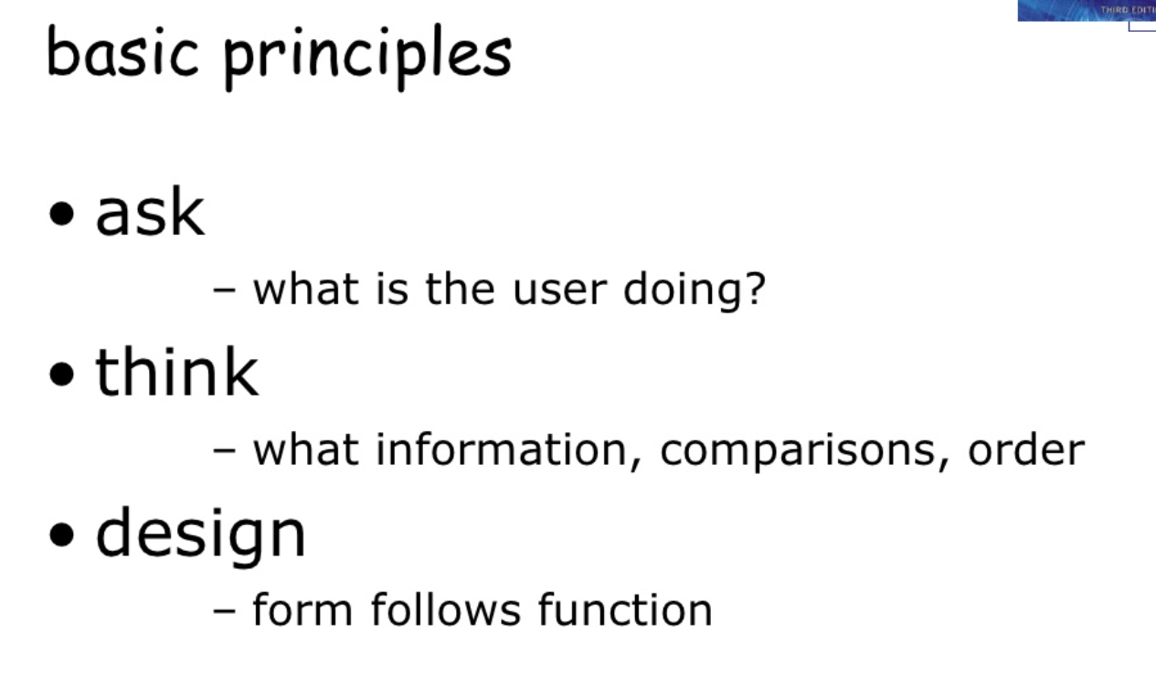

Slide 49
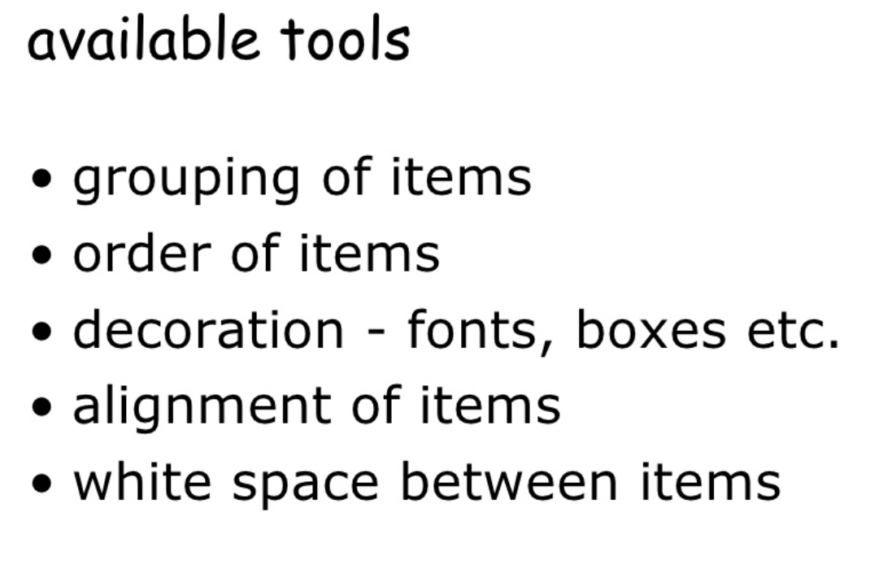

Slide 50
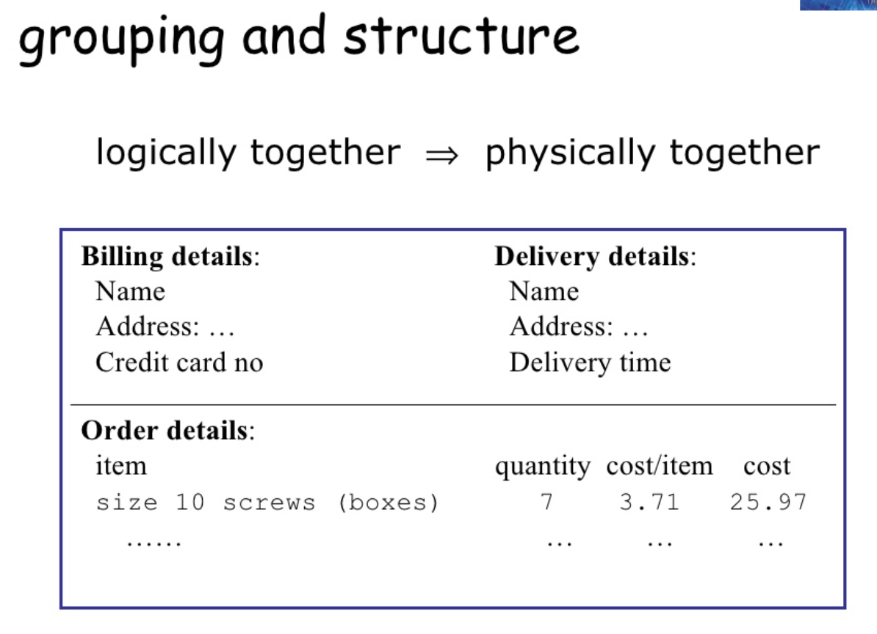

Slide 51
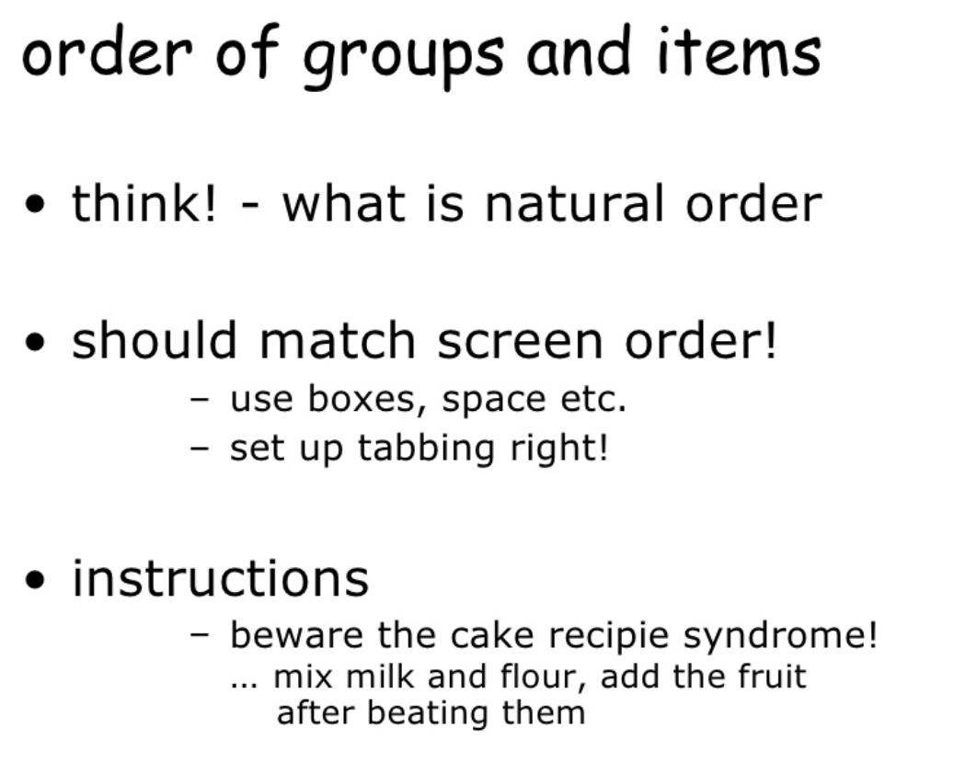

Slide 52
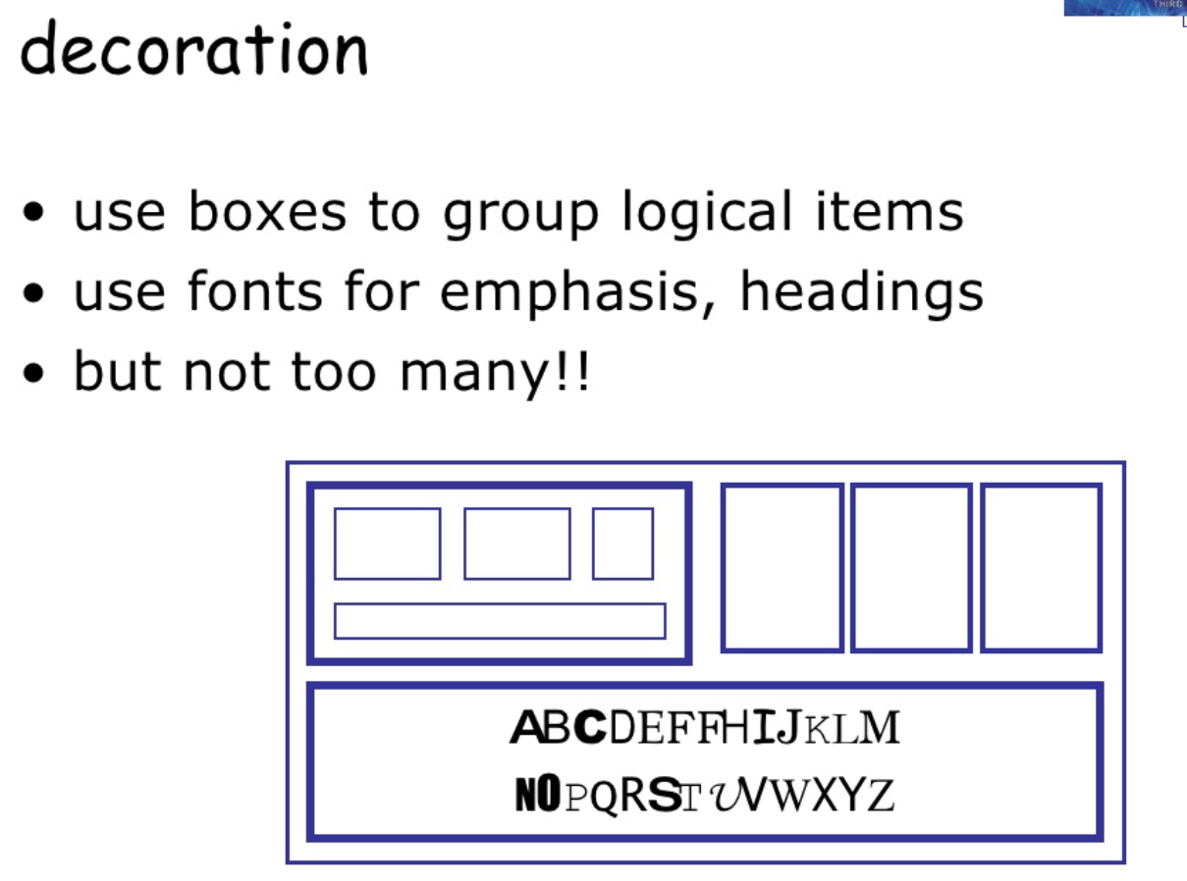

Slide 53
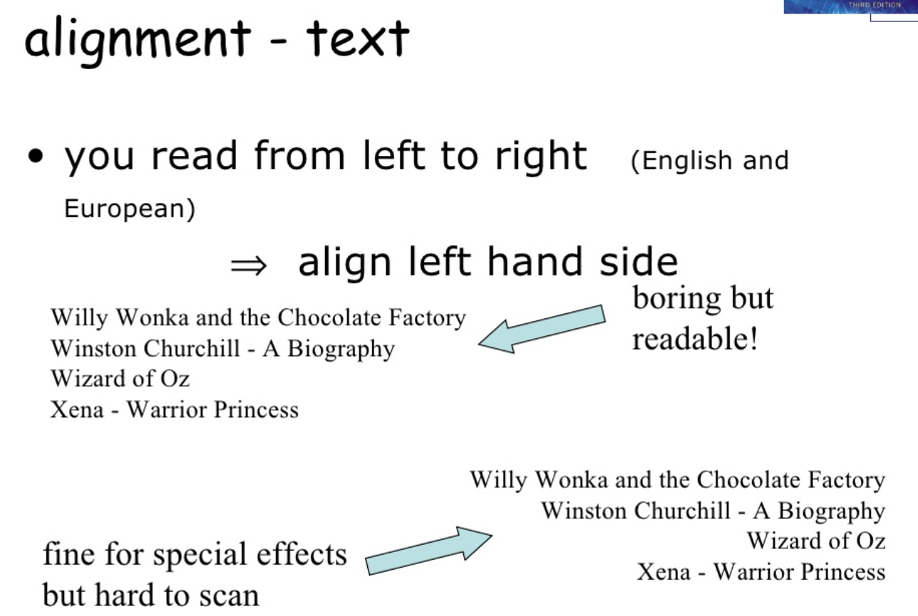

Slide 54
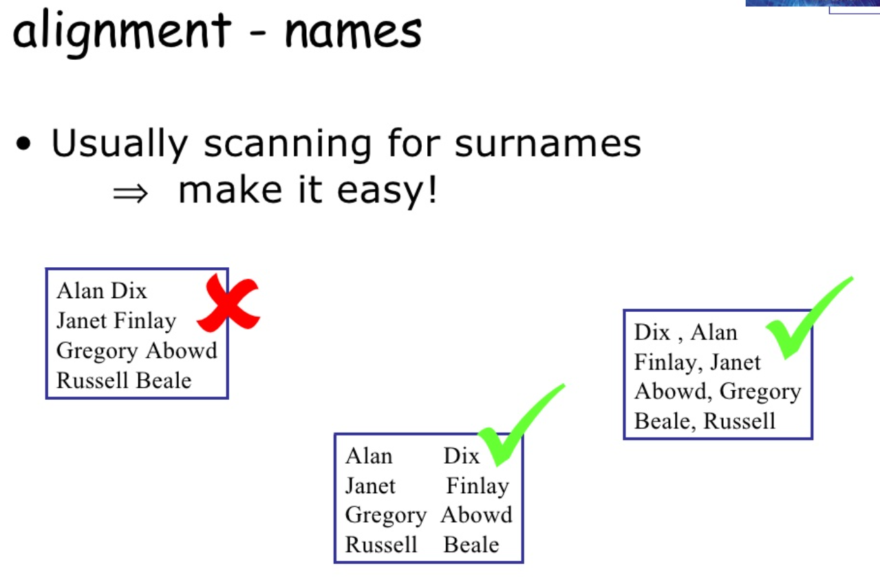

Slide 55
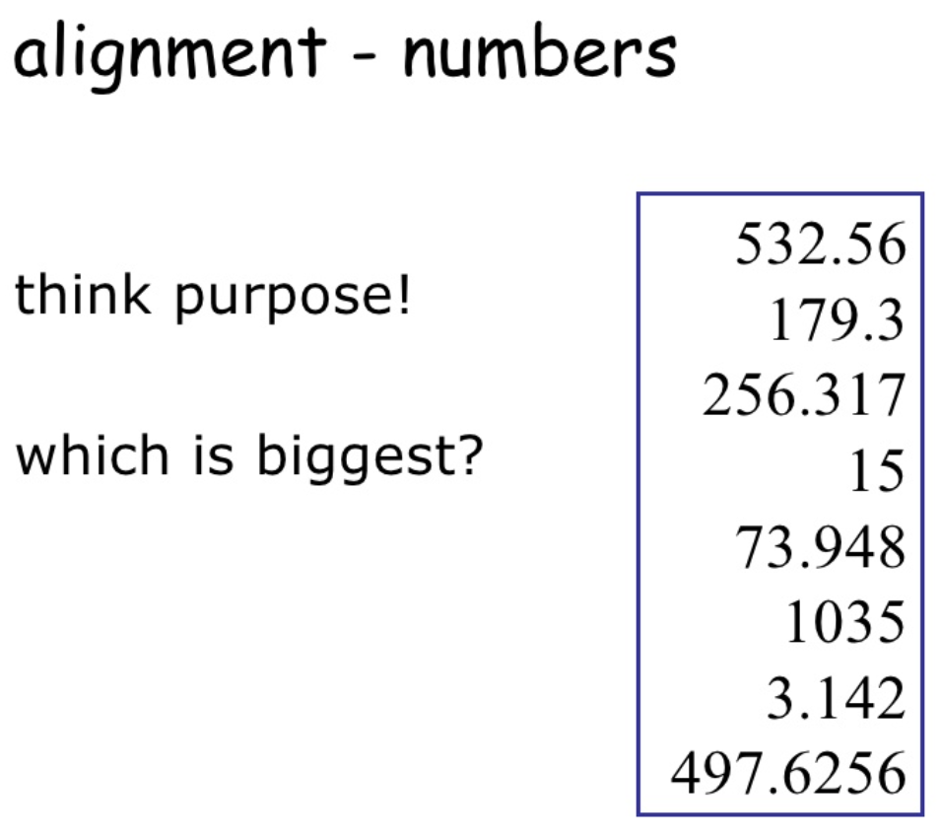

Slide 56
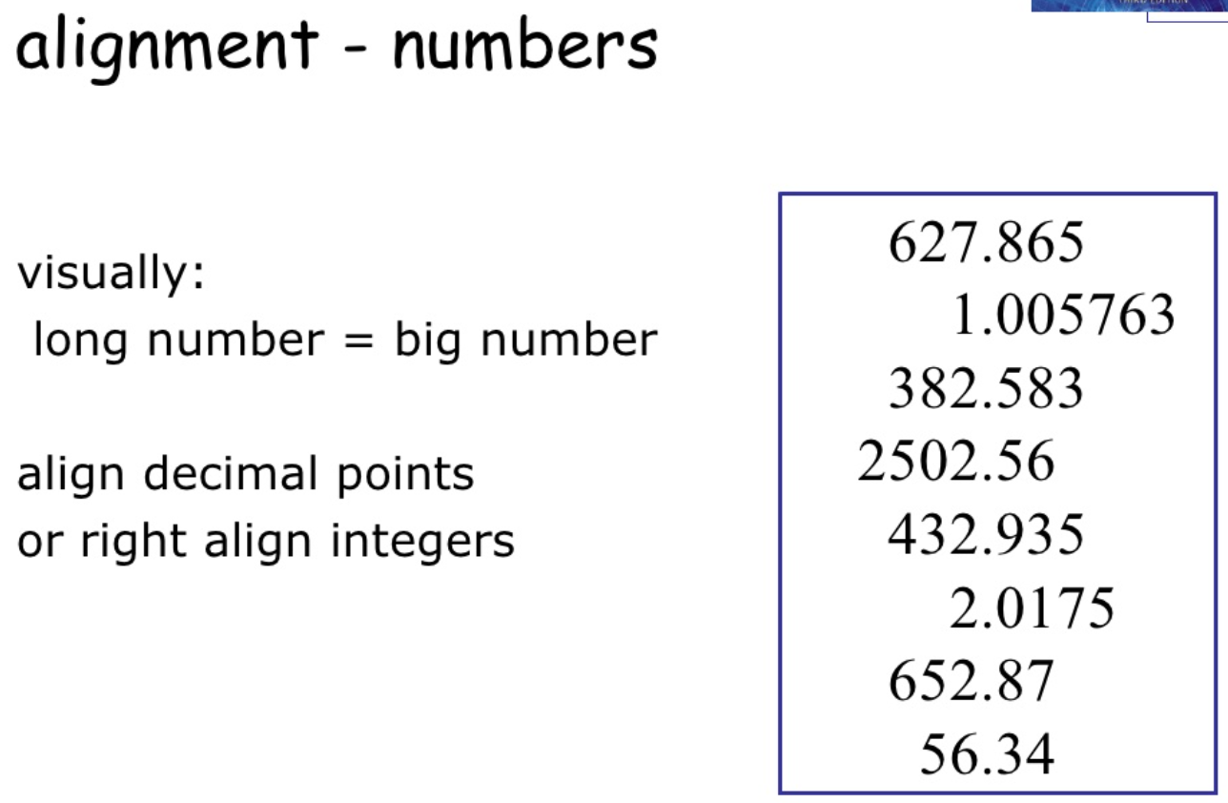

Slide 57
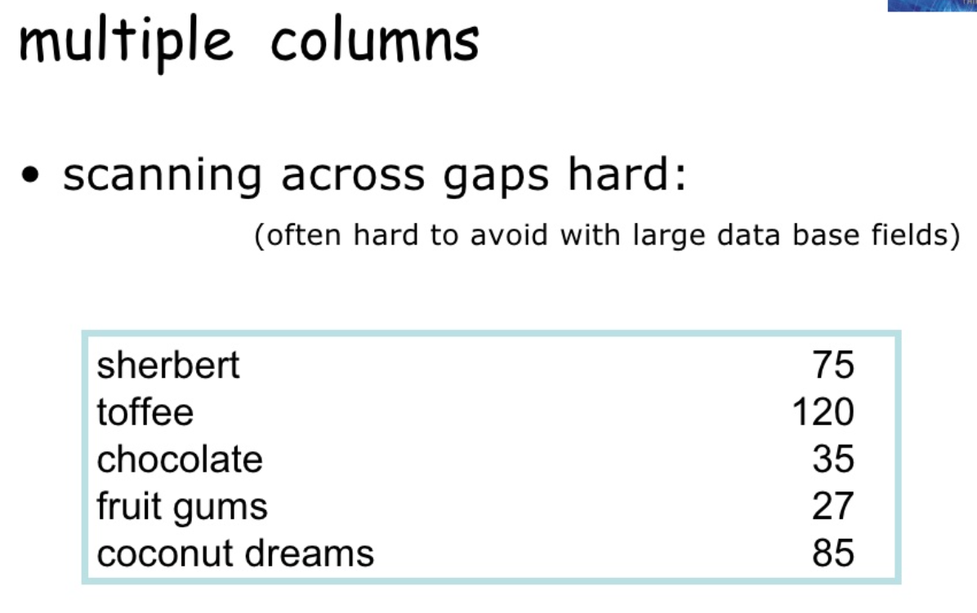

Slide 58
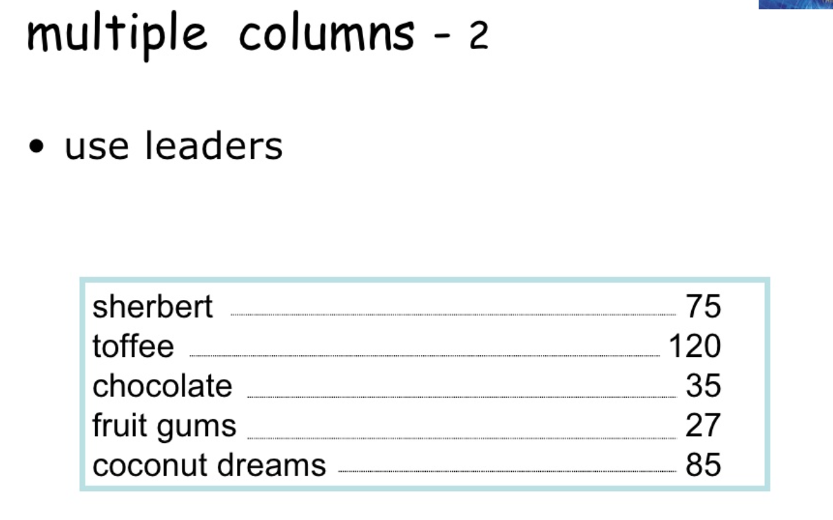

Slide 59
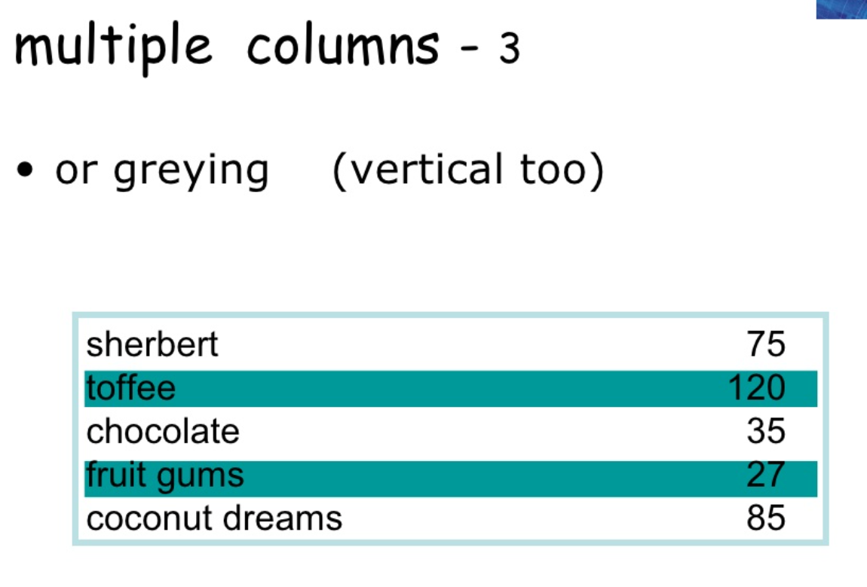

Slide 60
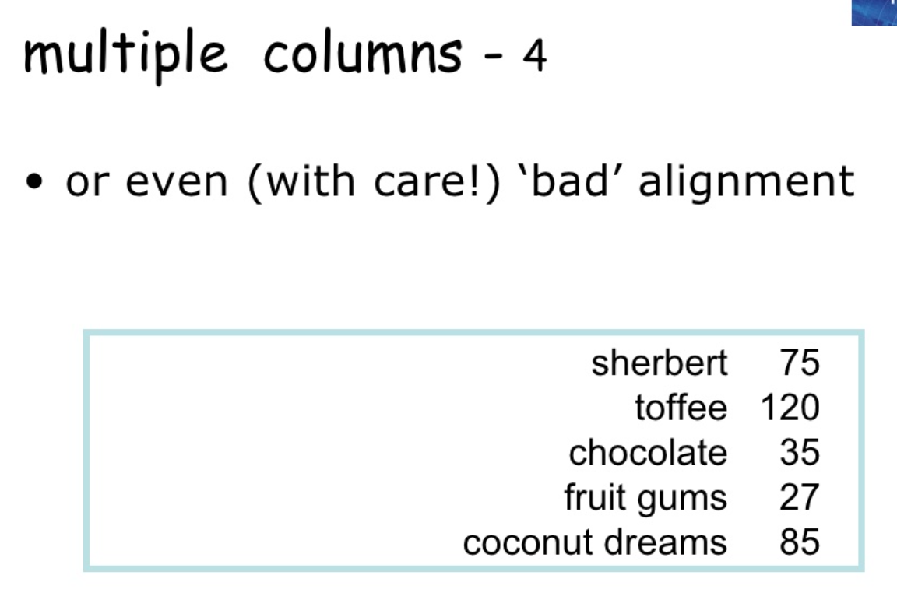

Slide 61


Slide 62


Slide 63
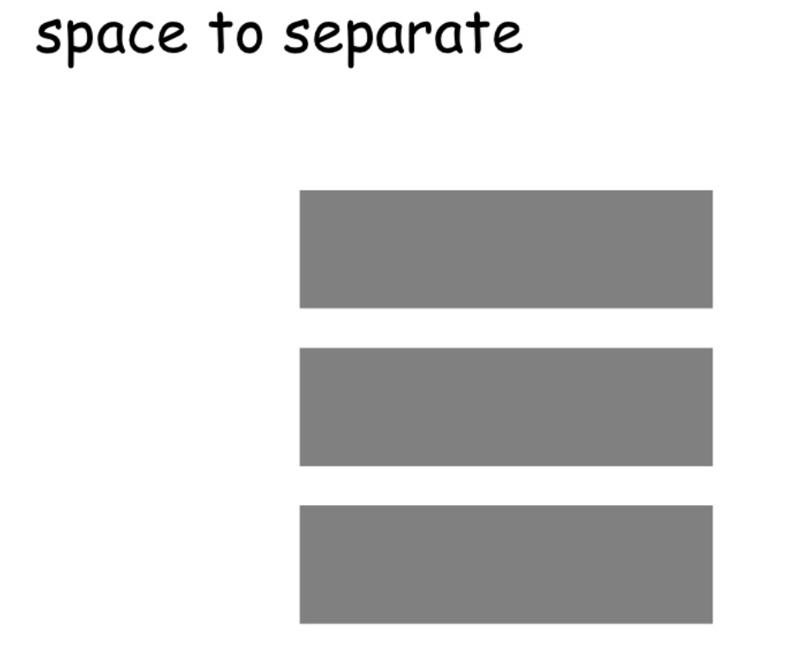

Slide 64
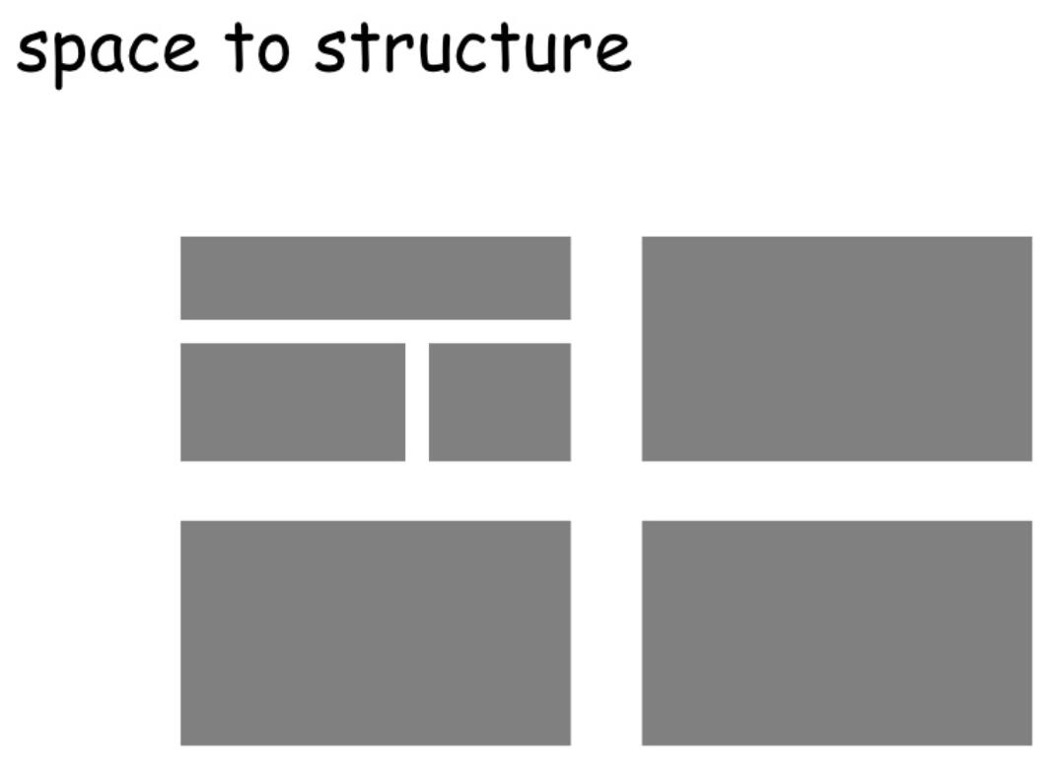

Slide 65
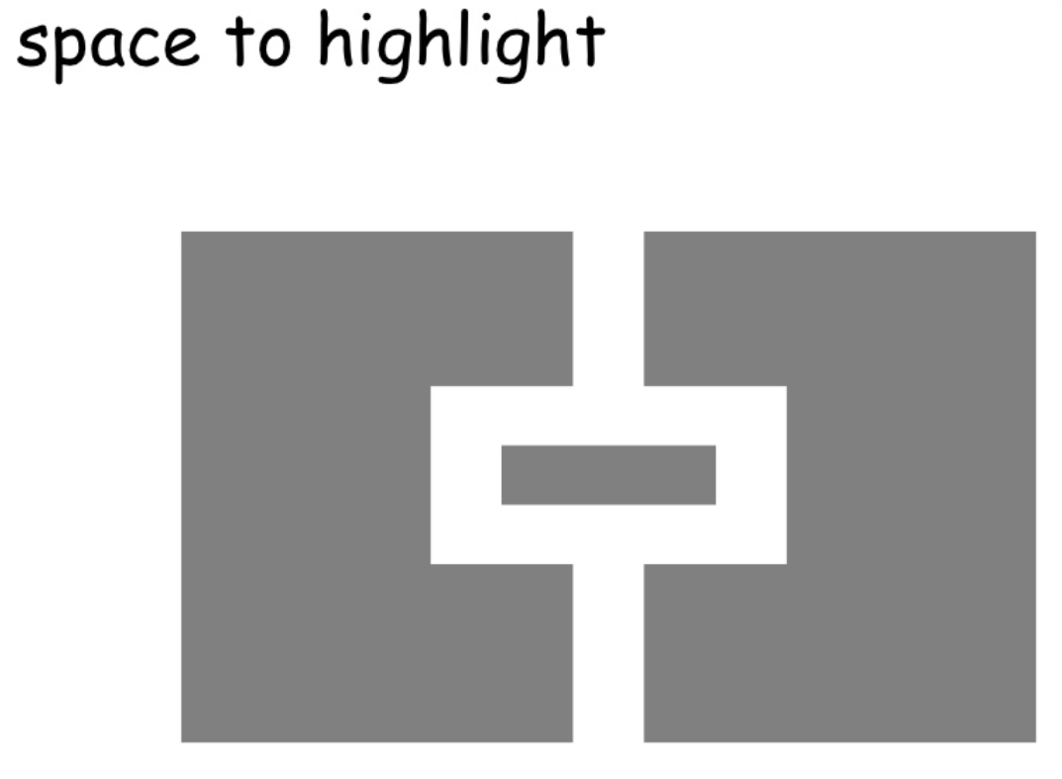

Slide 66
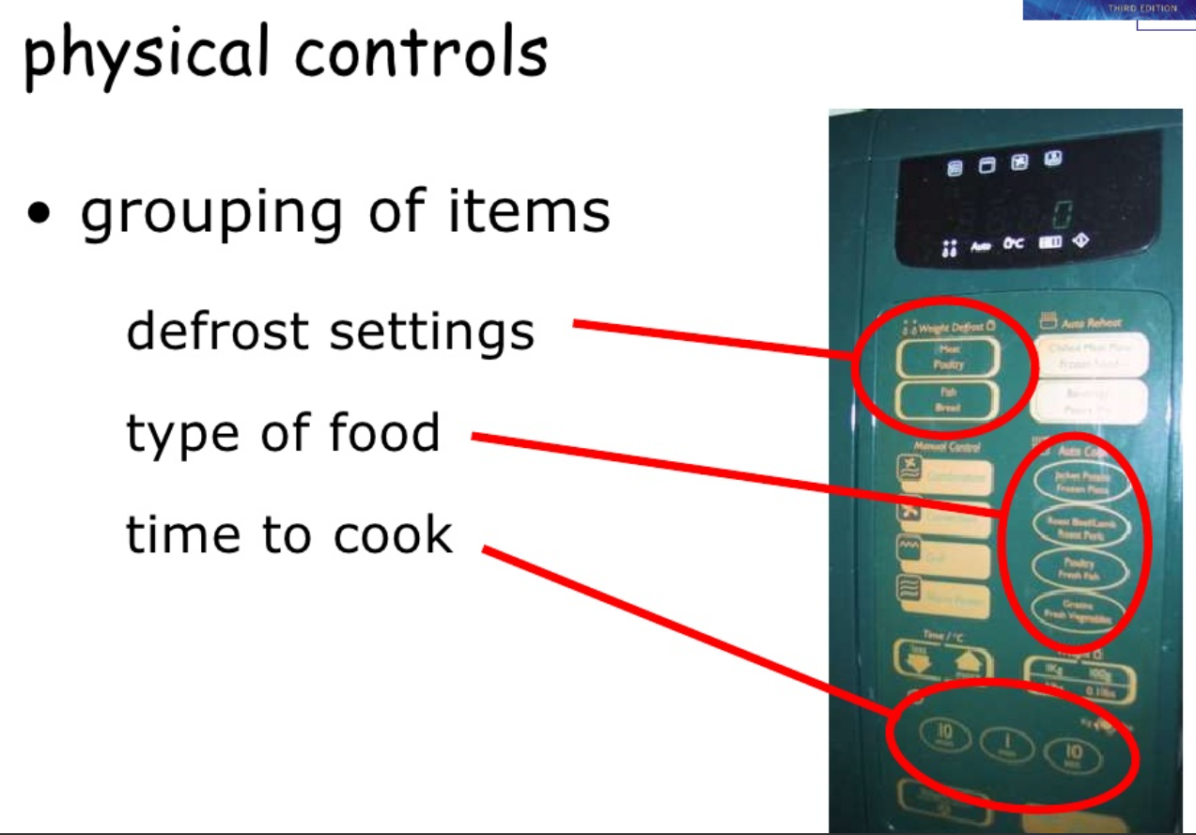

Slide 67
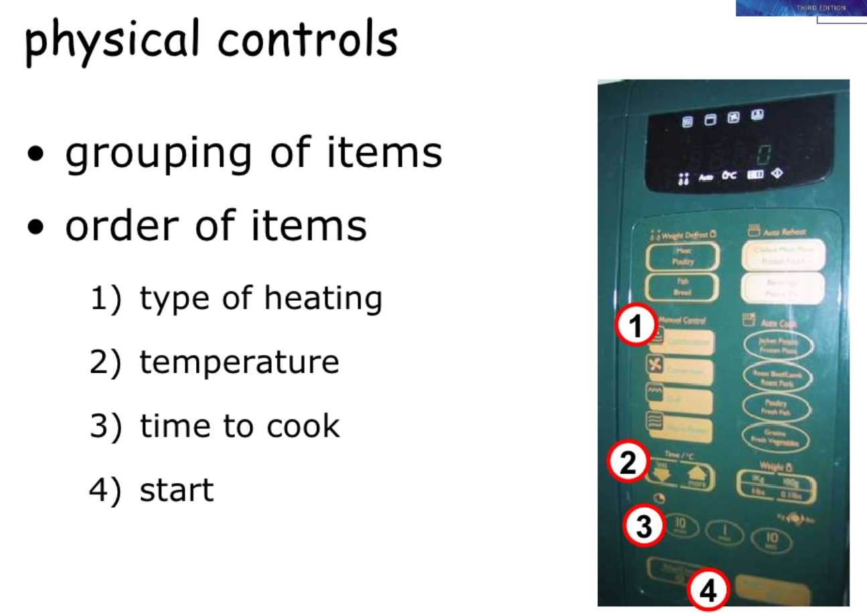

Slide 68
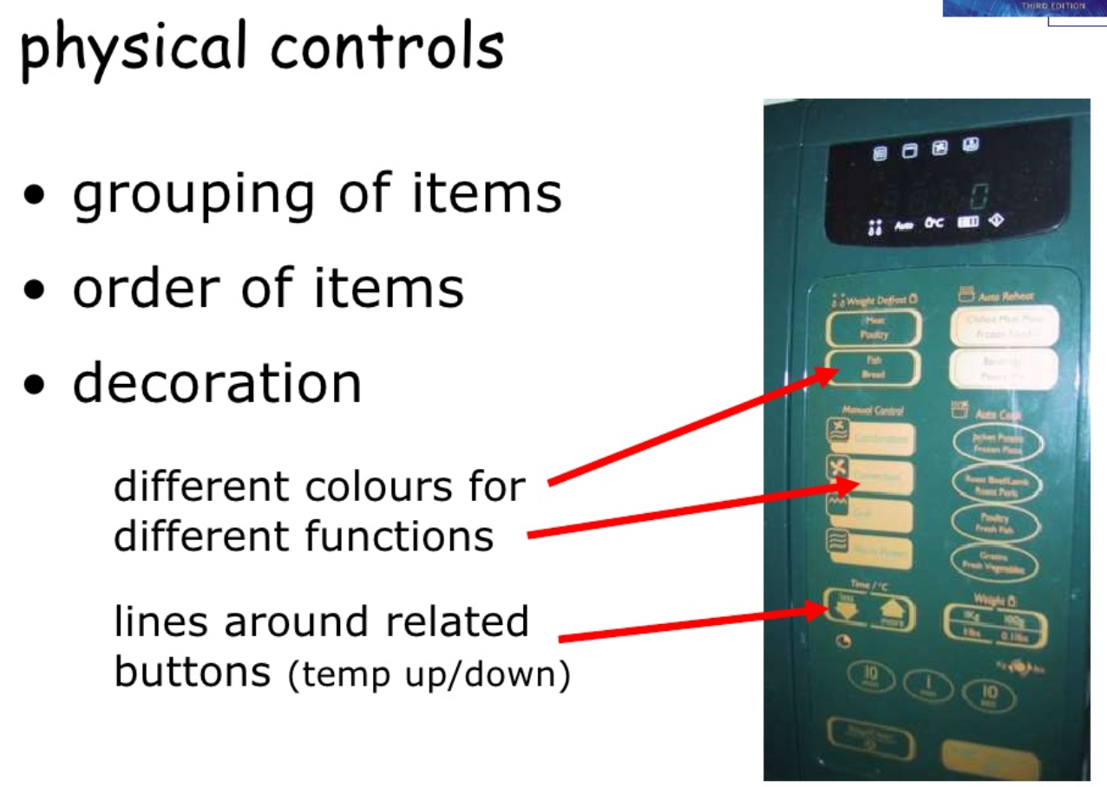

Slide 69
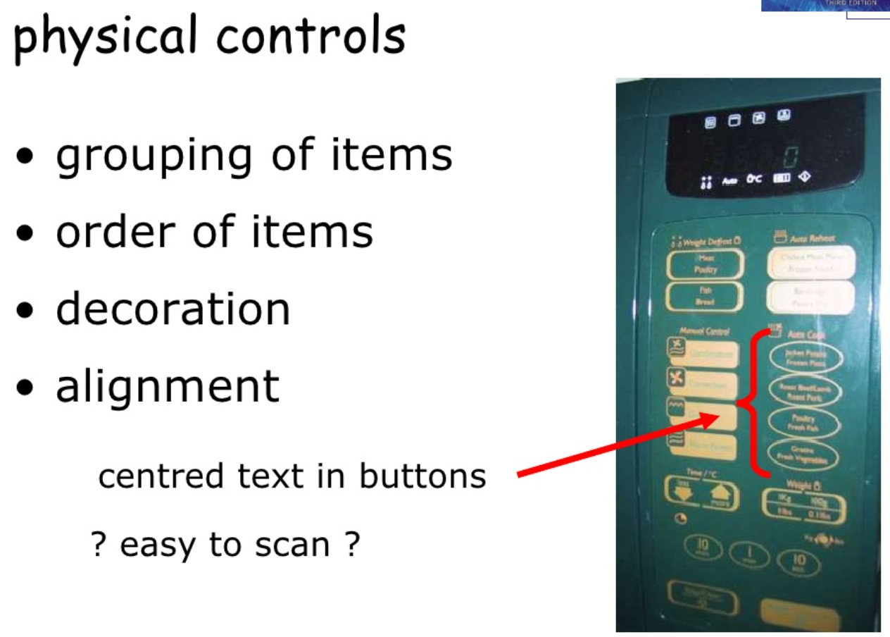

Slide 70


Slide 71


Slide 72


Slide 73


Slide 74


Slide 75


Slide 76


Slide 77


Slide 78


Slide 79


Slide 80


Slide 81
PROTOTYPING

Slide 82
INTERATION
AND
PROTOTYPING
Getting better…
… and starting well

Slide 83


Slide 84


Slide 85


5 Stages in the Interaction Design Process

Slide 86
03
PROJECT’S PROCESS
Use
cases
User
stories
Flow
Customers
Visual
style
Mockup
Usibility test
Brand
Goals
RESEARCH
(brief)
INSIGHT
&
ANALYSIS
UX
(Concept/
Ideate)
UI
DESIGN
DEVELOP
Business
Vision
Wireframe
Prototype
Personas
Motion
design
Graphic quality check
PRESENT TO CLIENTS & TEAM
Dev Back-end
UI designer
Dev Front-end

Slide 87


Thanks!
Do you have any questions?
chrizmonkey@gmail.com
+84 0937 566 561

